Slide 1
Model Evaluation Machine Learning
Data Science at Zindua School | By Chris Aloo

Slide 2
Model Evaluation Foundations

Slide 3
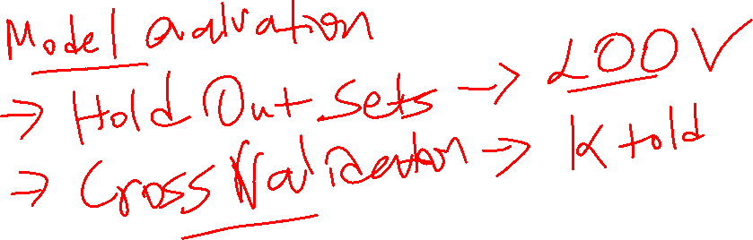

Slide 4
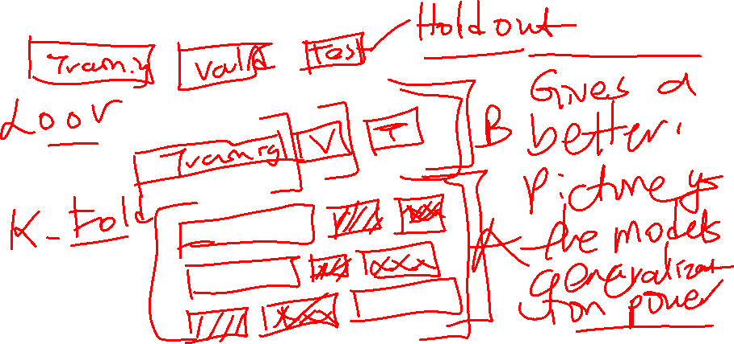
1 | Y-Actual | Predicted Y | ABS
2 | 936 | 908 | 28 | 798
3 | 1011 | 899 | 112 | 12,600
4 | 290 | 200 | 90 | 8,100
5 | 1101 | 810 | 291 | 84,827
6 | 290 | 359 | 69 | 4,761
7 | 100 | 979 | 879 | 772,641
8 | 633 | 761 | 129 | 16,512
9 | 950 | 796 | 154 | 23,716
10 | 1021 | 800 | 221 | 48,952
 |  | MAE | 219
 |  | MSE |  | 108,101
 |  | RMSE |  | 329

Slide 5
Regression Model Evaluation

Slide 6
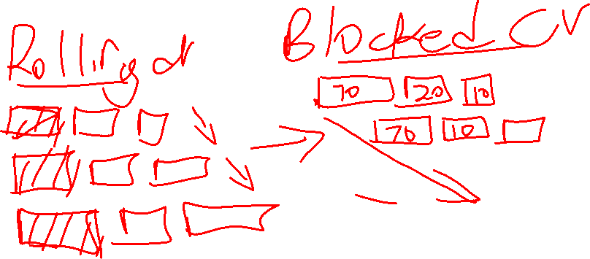

Slide 7
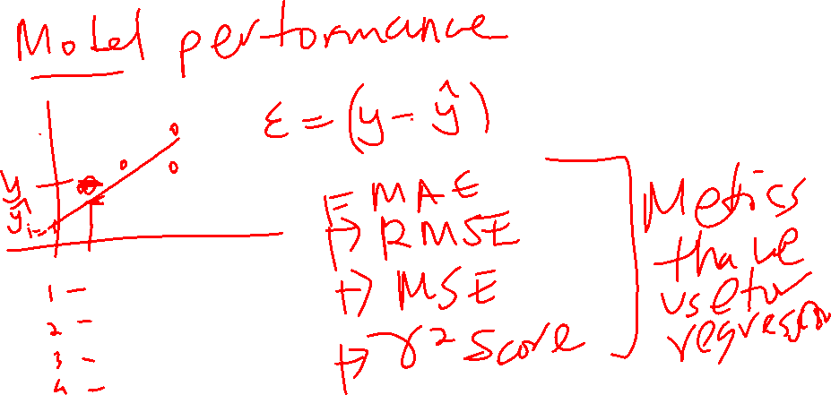

Slide 8
Classification Model Evaluation Metrics

Slide 9
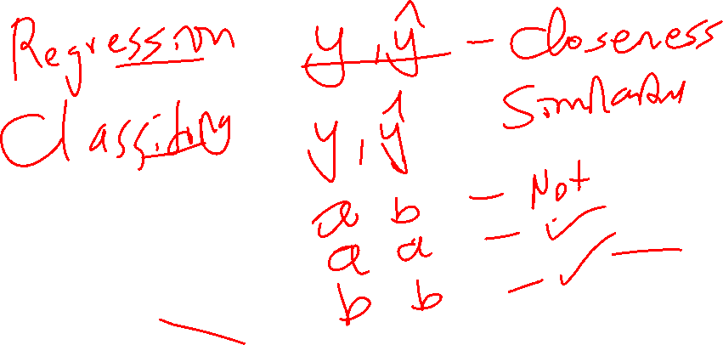
 | Confusion Matrix
 |  | Predicted
 |  | 1 | 0
Actual | 1 | TP | FN
 | 0 | FP | TN
 |  |  |  |  | Accuracy | =TP+TN/Total
 |  |  |  |  | Precision | =TP/FP+TP
 |  | Actual |  |  | Recall | =TP/TP+FN
 |  | 1 | 0 |  | F1 Score | = Harmonic Mean - Reciprocal of the mean of the reciprocals
Predicted | 1 | TP | FP
 | 0 | FN | TN
 | Non-Fradulent | Fradulent |  | Class Imbalance
 | 995 | 5 |  | 1000 | Accuracy | 99.50%
 |  |  |  |  | Recall | 0
 |  |  |  |  | 45
 |  |  |  |  | 95
 |  |  |  | Arithmetic mean | 70
 |  |  |  | Harmonic Mean | 60

Slide 10
Hyperparameter Tuning

Slide 11
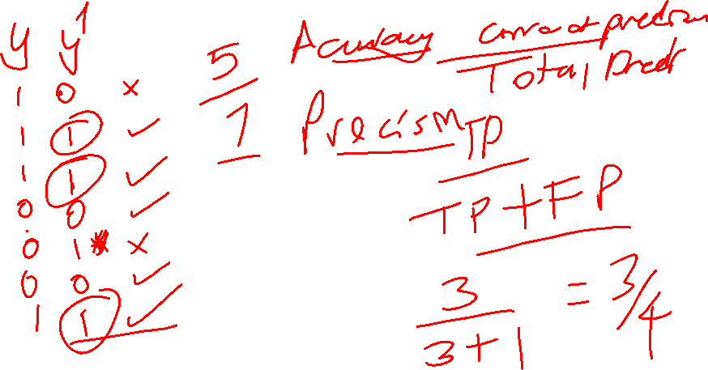

Slide 12
Error Analysis - Loss Curves - Validation Curves

Slide 14
Applied Machine Learning - GLMs - Gauss Markov Assumptions

Slide 16
End…

